Slide 1
Project One: Hive Queries
Timothy Miller

Slide 2
Project Summary
A series of scenarios which pose questions whose answers are not apparent
The provided dataset is partitioned across several files
Perform appropriate queries to join the data and extract the requisite information
Technology used
Hadoop Distributed File System (HDFS)
Hive
DBeaver

Slide 3
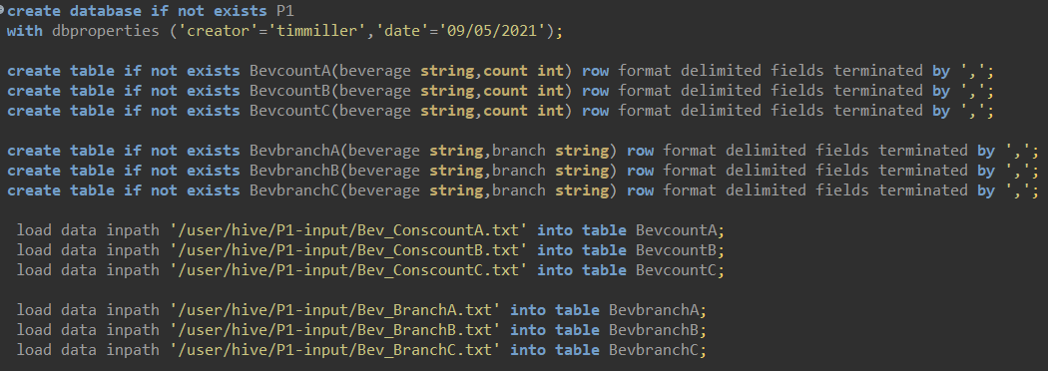
Loading the Data

Slide 4
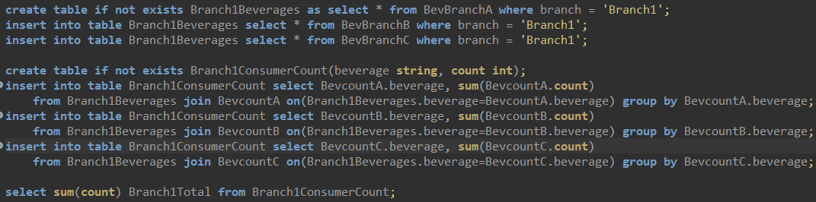

Scenario 1: part 1
What is the total number of consumers for Branch1?

Slide 5
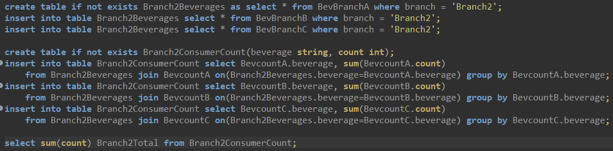

Scenario 1: part 2
What is the total number of consumers for Branch2?

Slide 6


Scenario 2
What is the most consumed beverage on Branch1
What is the least consumed beverage on Branch2

Slide 7
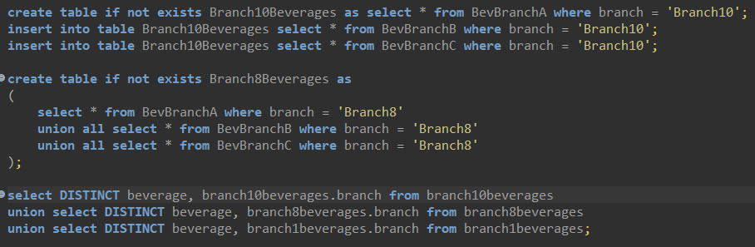
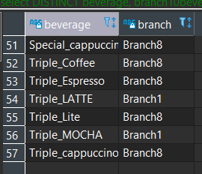
Scenario 3: part 1
What are the beverages available on Branch10, Branch8, and Branch1?

Slide 8
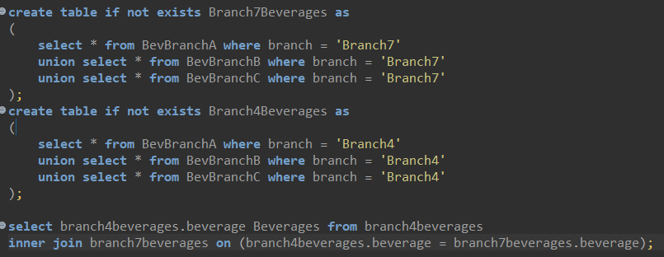
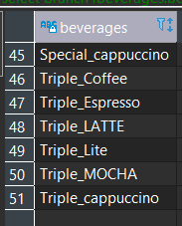
Scenario 3: part 2
what are the comman beverages available in Branch4,Branch7?

Slide 9
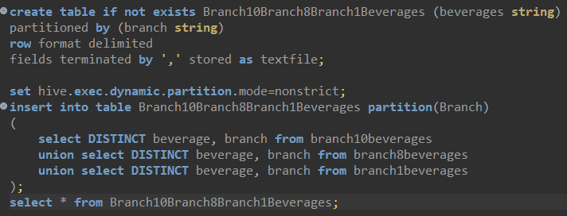
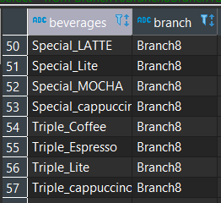
Scenario 4: part 1
Create a partition for scenario 3.

Slide 10
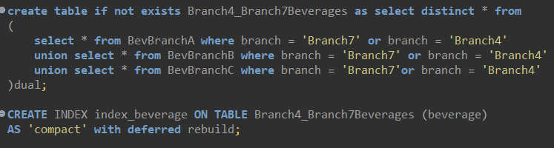
Scenario 4: part 2
create an index for scenario 3.

Slide 11
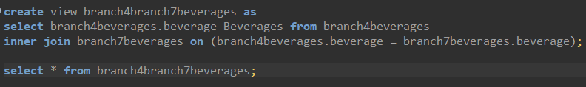
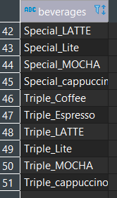
Scenario 4: part 3
Create a view for scenario 3.

Slide 12
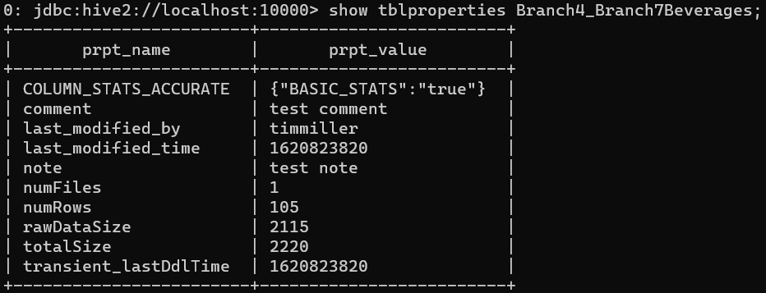
Scenario 5
Alter the table properties to add "note","comment".

Slide 13
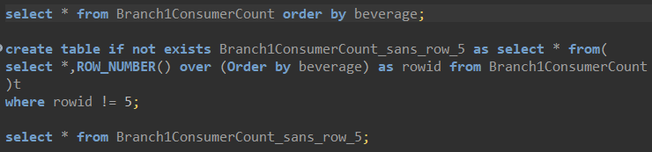
Scenario 6
Remove the row 5 from the output of Scenario 1.

Slide 14
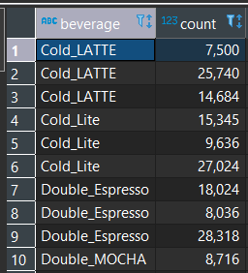
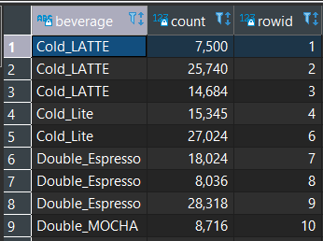
Scenario 6: tables

